Slide 1


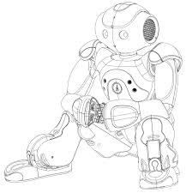
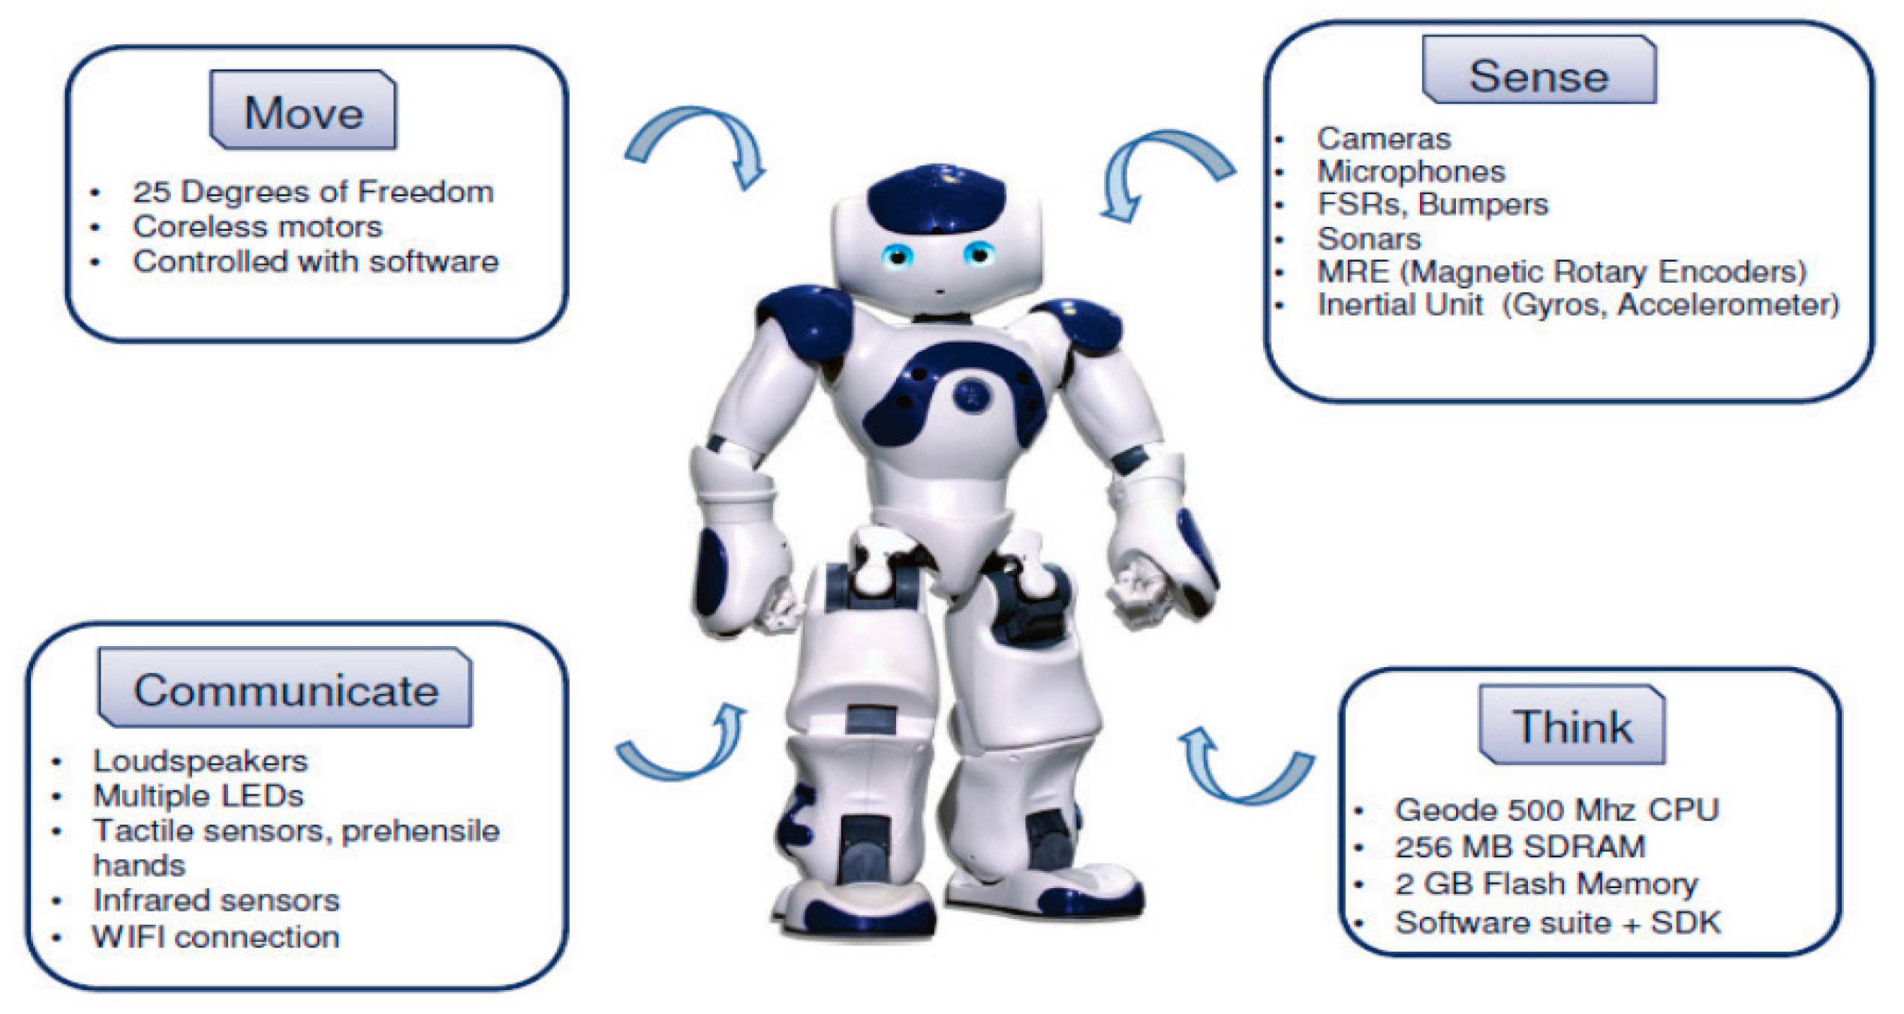
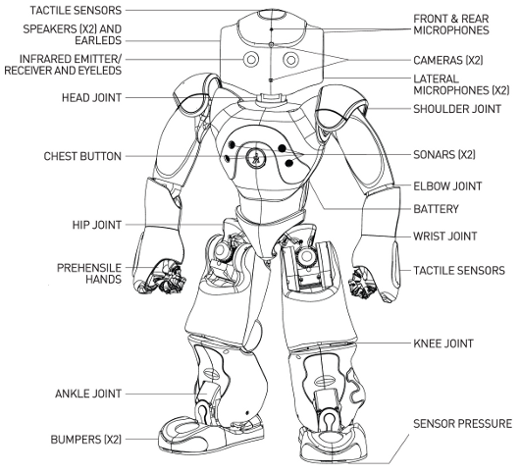
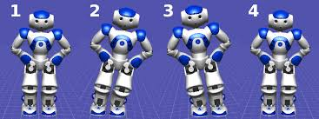

HUMAN INTERACTION WITH NAO HUMANOID
Supriya .R
Jashwanth .D
Indraneel .S
Shashank Yadav
Mentor: Dr. Tapas Badal
Abstract
This project defines about the NAO humanoid robot interaction with humans as a receptionist in an organization. It exhibits the face detection, speech recognition and human activities like walking and dancing. These tasks are achieved using stimulation software CHOREGRAPHE which is based on Graphical User Interface (GUI). The instinct of this project is to test NAO Humanoid Robot for interacting with humans in voice, movement and face activities.
The Box starts when a signal is received on this input
TEXT from Interview control module. The input of this module is a text string block. The Box sends a signal when the robot finishes talking (VOICE_END). The output signal is Boolean data type. Figures 3 illustrate the talk activities relevant to formal version, food and sports relevant conversation. The probable questions to which the NAO was trained, and the answers are given bellow the following figures. It is observed that the outcome of the
Introduction
This project defines about the strategies and operations of NAO Humanoid robot which are practically exhibited with the prototyped working model This section explains the salient features of the NAO robot. The humanoid Robot NAO is a humanoid robot developed by a French Company called Aldebaran and later it is taken over by SOFTBANK ROBOTICS It is an open platform where the user can change all the embedded system software or just add some applications to make the robot adopt specific behaviors. The height of the NAO robot is 23 inches and it can walk on various varying slope surfaces and recognize faces & voices and even react to touch with emotions. The appealing appearance and features of the sophisticated sensor network, including two cameras, four microphones, a sonar range network, including two cameras and receivers, one mother board in head.
The Nao Humanoid can also show the locations of a particular place inside an organization to its new clients as it acts as an receptionist
NAO is a combination of hardware and software product merged with choregraphe program with GUI tool.
Proposed Method
The ability of the Nao Humanoid to communicate with humans is achieved with the help of CHOREGRAPHE .
CHOREGRAPHE is a sort of stimulator and using the internet connection the choregraphe can be connected to the NAO Humanoid in order to change the NAO Humanoid’s Behaviour.
CHOREGRAPHE contains dialog boxes which is responsible for each and every action done by NAO.
Conclusions
The NAO robot is able to interact with its clients as a receptionist.
The limitation in our project is that the NAO Humanoid can only respond to questions asked in English.
The further implementation and advancement of this project is to make the NAO communicate in different languages.
Experimental Results and Discussion
References
This section presents the approach proposed for the behaviors NAO model applied to various human interaction processes. The following illustrations describe what was technically done to implement and the components that were created to provide a bridge between the human and the robotic control software. In the third zone the picture of the NAO robot was displayed to ensure the execution of the Choregraphe software tool. Fig.3 describes the general information about the institution. The questions are given below the figures and answers are given in the say module which connected to each switch statement below
D.Gouaillier, V.Hugel, P.Blazevic, C. Kilner, P.Lafourcade, B.Marnier,…B. Maisonnier, “The NAO humanoid: a combination of performance and affordability” 2008, pp.1-10.
D. Maisonnier et al., “Mechatronic design of NAO humanoid” IEEE international conference on Robotics and Automation, Japan, 2009, pp.769-774.
Team No. - 16

